Slide 1
DATA 403 Final Presentation
Student ID: 2018320230
Name: 박현우

Slide 2
Contents
Introduction
Method
Experiments
Conclusion

Slide 3
Introduction
Mujoco halfcheetah
Observation space: 17 dimensions, x, z coordinates, x, y velocitis, angles
Rewards : Forward reward – Control cost
Forward reward : coordinate difference, velocity
Control cost : sum of (actions)^2
Actions: Torques of rotors (-1.0, 1.0) continuous, 6 dimensions

Slide 4
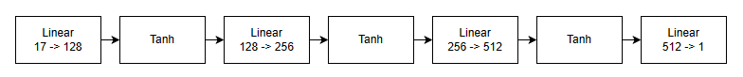
Method
Neural networks
Critic
Actor
Used Value Clipping
In the same way as clipping gradient of policy loss

Slide 5
Experiments
Experimental setting
Used 4 parallel env for 1000000 timesteps
Rollout buffer size = 2048
anneal learning rate: True
Lr = 3e-4, normalize advantages, clipping max gradient to 0.5
Clipping policy change to (-0.2, 0.2), vf_coef = 0.5, ent_coef=0.0
gamma = 0.99, gae_lambda = 0.95
Minibatch size = 64
Epoch = 10

Slide 6
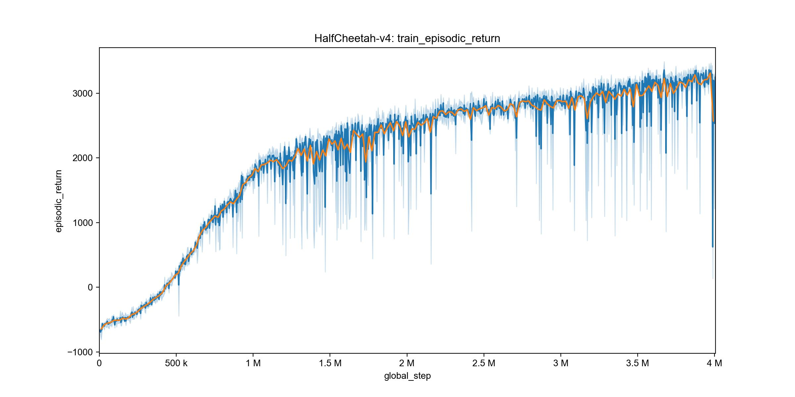
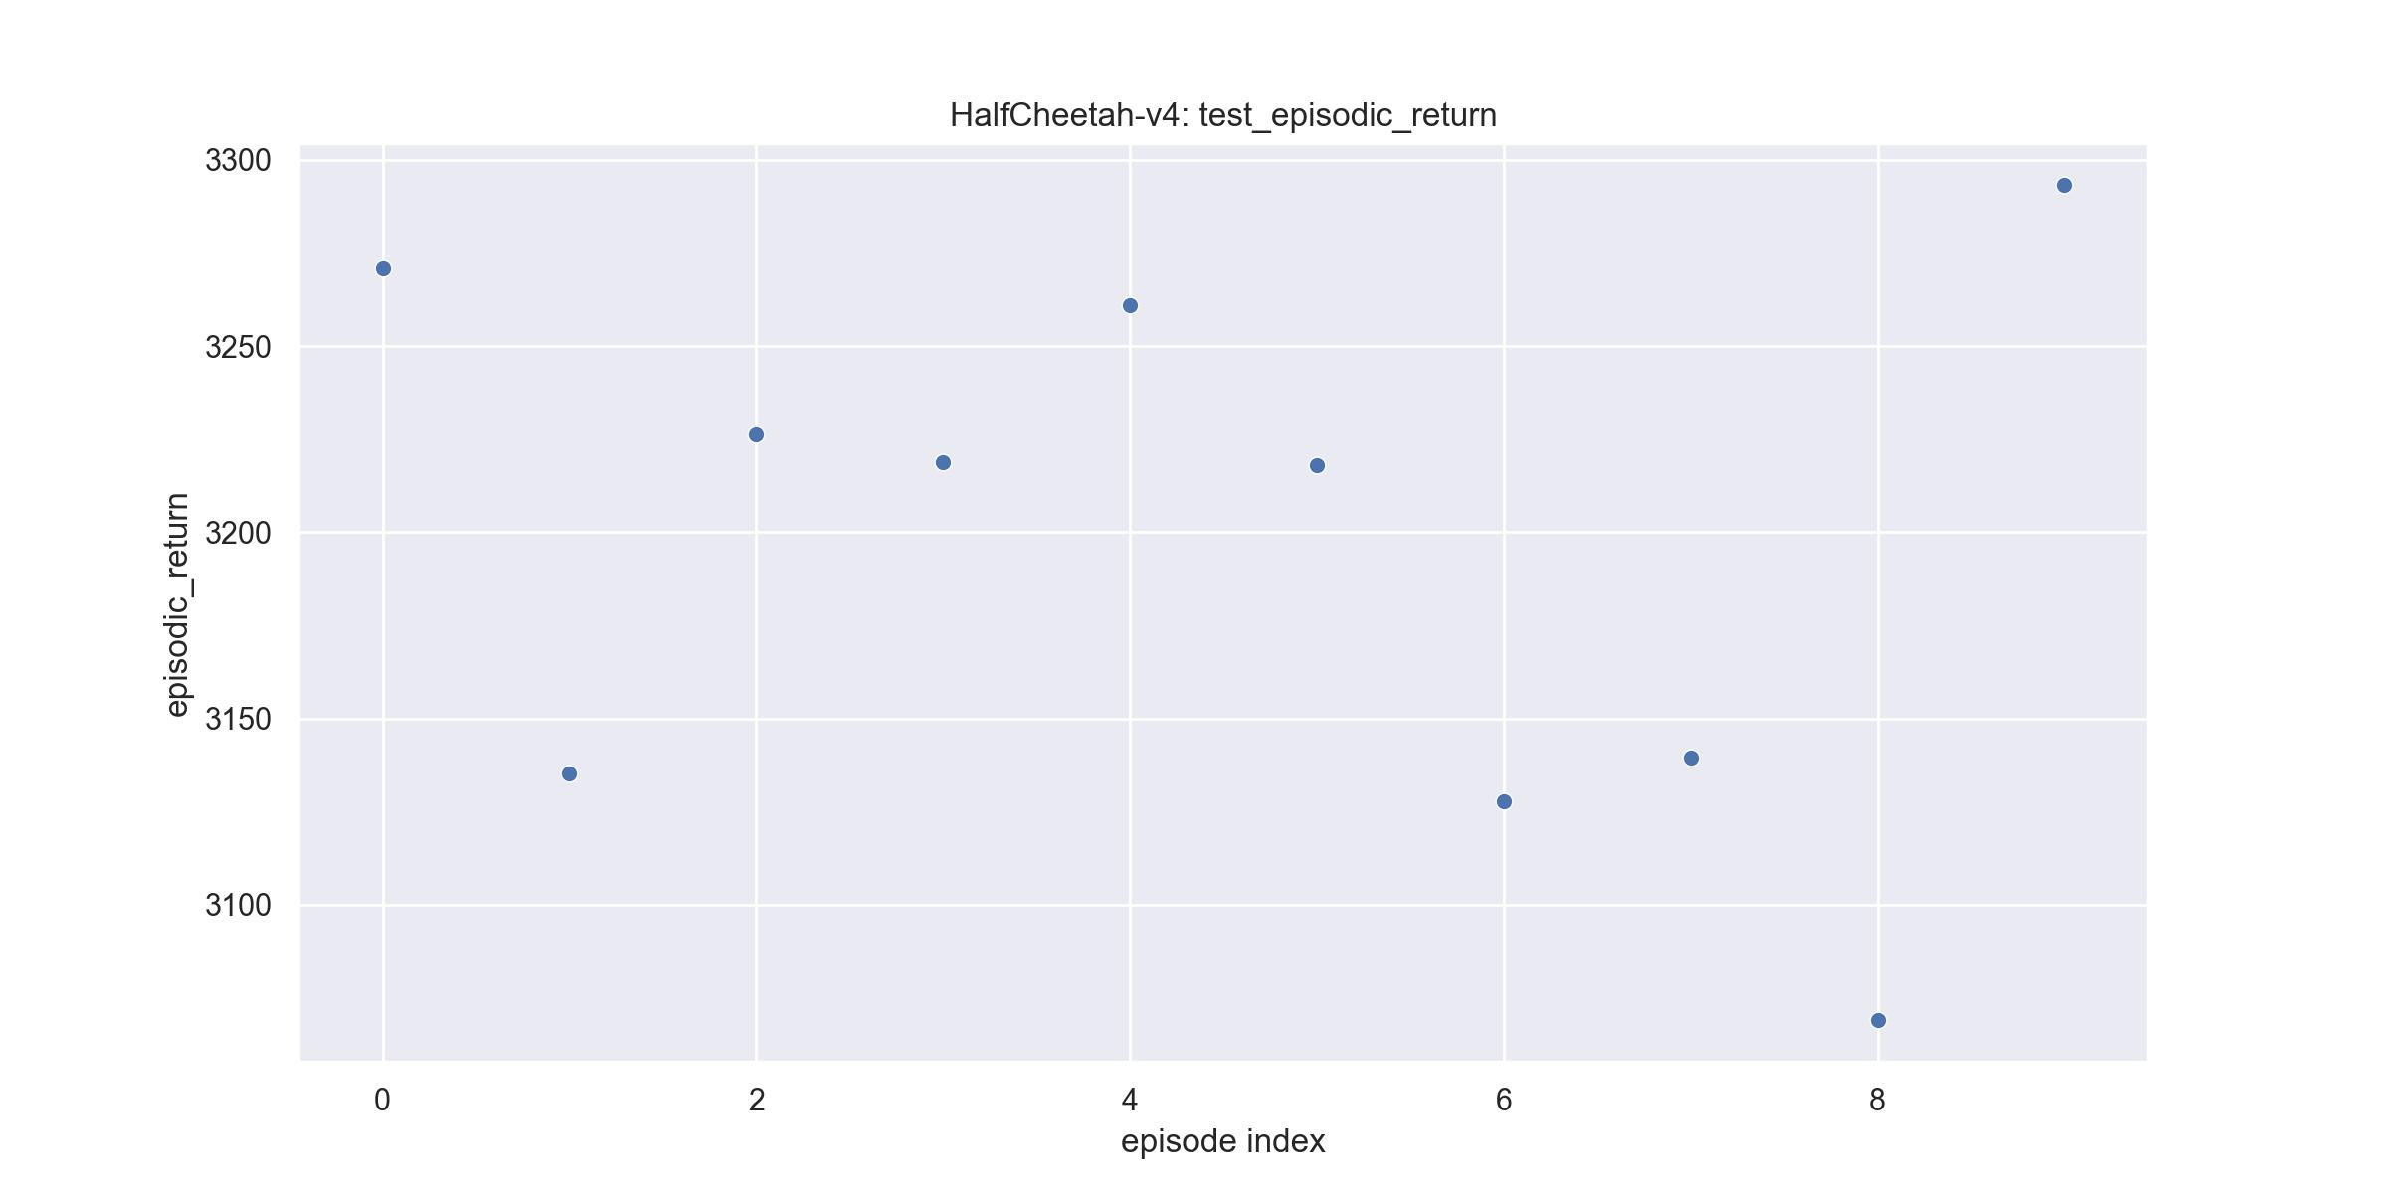
Experiments

Slide 7
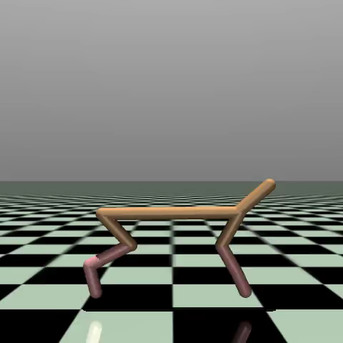
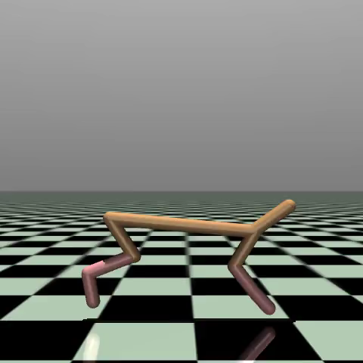
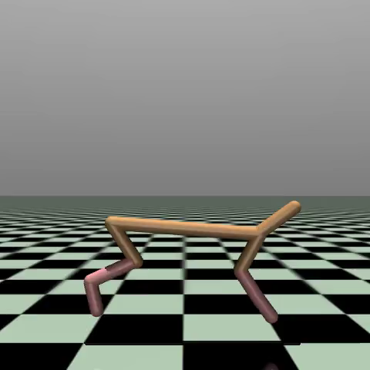
Experiments

Slide 8
Introduction
Atari Pong
Observation space : (210, 160, 3) RGB visual space
Rewards
+1.0 for winning a round
0.0 for ongoing round
-1.0 for losing a round
Actions : 6 dimensions discrete

Slide 9
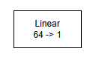
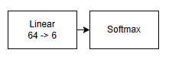
Method
Neural networks
Shared network
Critic
Actor
Used Value Clipping
In the same way as clipping gradient of policy loss

Slide 10
Method
Observation reshaping
(210, 160, 3) RGB space to (1, 84, 84) grayscale space
Preventing reward propagation
If reward is not 0.0 (A round is done), done mask is set to 1.0 so that next round doesn’t update advantage of previous round

Slide 11
Experiments
Experimental setting
Used 8 parallel env for 15,000,000 timesteps
Rollout buffer size = 128
anneal learning rate: False
Lr = 2.5e-4, normalize advantages, clipping max gradient to 0.5
Clipping policy change to (-0.2, 0.2), vf_coef = 0.5, ent_coef=0.01
gamma = 0.99, gae_lambda = 0.95
Minibatch size = 256
Epoch = 4

Slide 12
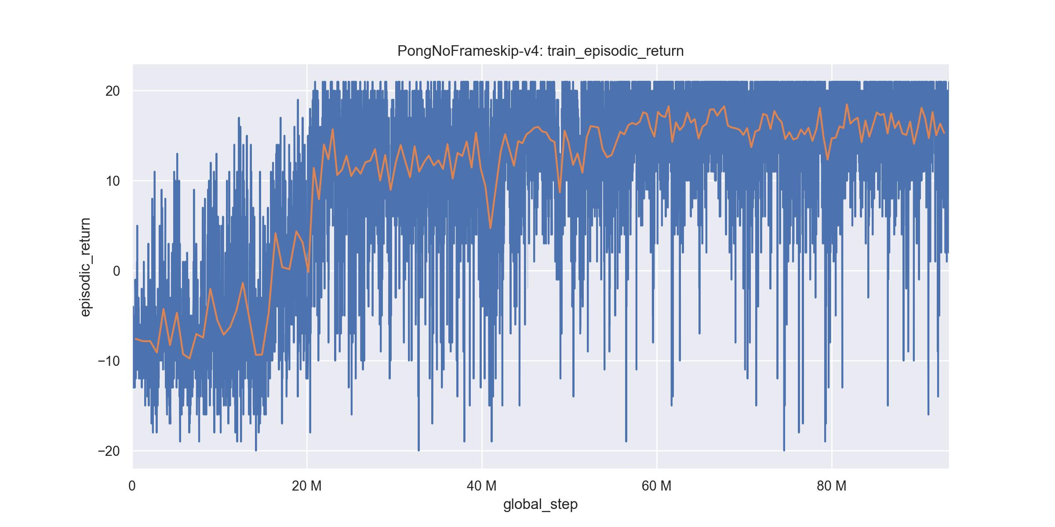
Experiments
Result for update 25000 ~ 117000
Global timestep 20,000,000 ~ 93,490,000

Slide 13
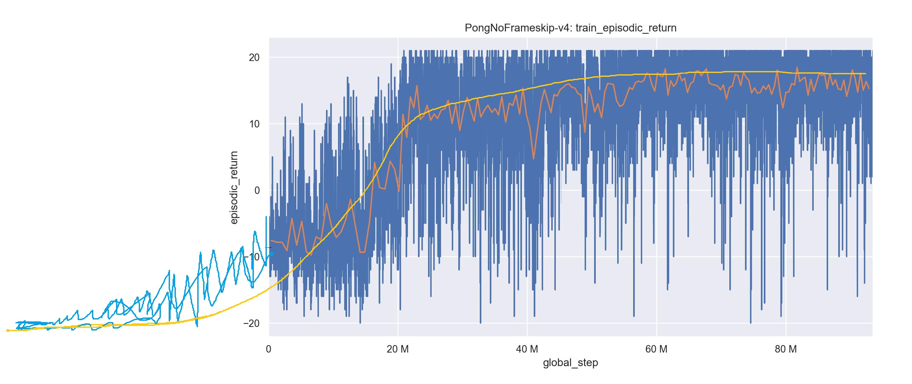
Experiments
Approximation of ~ 117000

Slide 14
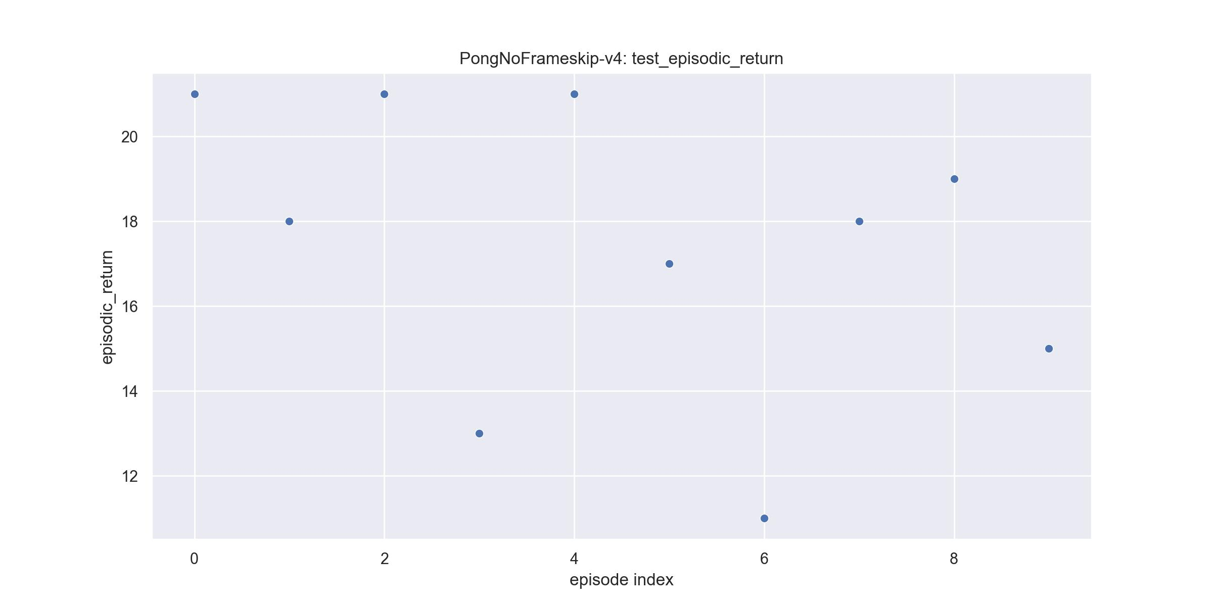
Experiments

Slide 15
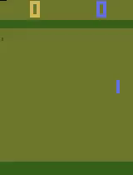
Experiments

Slide 16
Conclusion
Analysis of the experiments
Atari took very long time to start winning a round
Without separating round with done mask, losing next round will make advantages on previous round decrease
In Atari Pong removing score part of observation space might have better result
Every winning round appears to have similar situation
Game starting state might not be uniformly distributed
More update iteration might result better

